Slide 1
Introduction to J2EE Architecture

Slide 2
Distributed Multi-tiered Applications
The J2EE platform uses a multi-tiered distributed application model for both enterprise applications
Application logic is divided into “components” according to function, and the various application components that make up a J2EE application are installed on different machines depending on the tier in the multi-tiered J2EE environment to which the application component belongs

Slide 3
The J2EE technologies can be broadly classified into four different categories:
  Client-side technologies
  Component technologies
  Service technologies
  Communication technologies
Component technologies include:
  Servlets
  Java Server Pages
  Enterprise JavaBeans
    Session Beans
    Entity Beans
Service Technologies include:
  Java Database Connectivity
  Java Transaction API and Service

Slide 4
Client-Server Architecture
CLIENT
SERVER
Application
Business Logic
Data
Presentation Logic
Clear division between Application and Data
Entire processing load on client
Server acts as traffic controller
2-Tier Architecture

Slide 5
Client-Server: The Drawbacks
Business logic present on each client
Client waits longer for response
Business logic + presentation logic bundled together-therefore scalability problems
Load on server and network as all clients send request to 1 server
Tiny change to application— entire application has to be changed, and the clients upgraded

Slide 6
3-Tier Architecture
MIDDLE TIER/
APPLICATION TIER
CLIENT TIER
DATA/EIS TIER
DATA
Presentation
Logic
Business
Logic
Receives request for data, retrieves it, and returns it to client

Slide 7

3-Tier Architecture: the benefits
Firewall
Business logic shared between clients; same data returned by data & application tier –presented differently on different clients
Business logic can be changed without impacting clients
Middle tier can be hidden behind firewall
Application
Server
Maximum use of available system resources
Parts of architecture can be rewritten without rewriting whole app

Slide 8
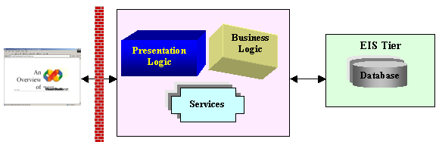
Traditional n-Tier Architecture
Firewall
Browser
Application Logic= Presentation logic + Business Logic
Infrastructure services provide additional functionalities required by application, such as messaging services and transactional services.

Slide 9
Traditional n-Tier Architecture: The Characteristics
Business logic and presentation logic in same module
Database connectivity through same module
Scalability low
Business logic difficult to update
Client & Server – stateless communication
Business logic unaware of different client identities
Client has to maintain state

Slide 10
Overcoming the drawbacks - Improving the system
PROBLEM
SOLUTION
Middle Tier contains one App object
Extend the middle tier to create one more layer
For different types of needs-different app objects required
Allow multiple application objects to reside on the server
Different application objects may not be able to communicate with each other
Use interfaces to communicate between application objects

Slide 11
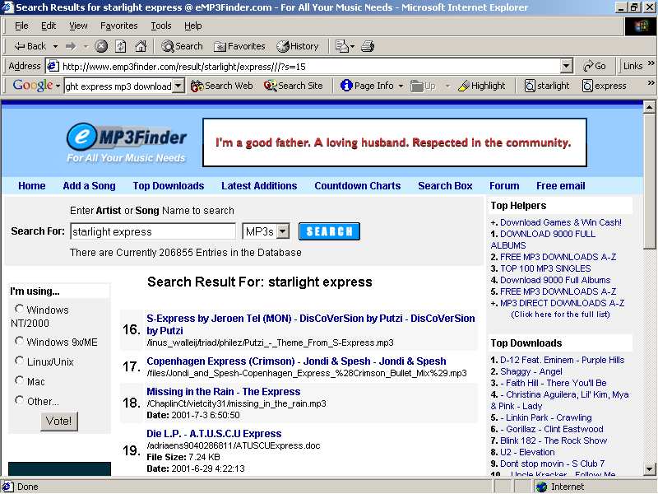
Component n-tier Architecture
Interfaces
Component A
Database
Component B
Component C
Application object broken into components that can communicate with each other, through interfaces

Slide 12
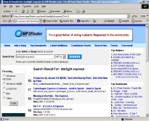
Component Based n-Tier Systems
Comp A
Comp B
Database
Comp C
Component objects maintain identity and encapsulate remote methods
Components can be designed to maintain session state on server
Business logic can be modified without affecting other logic

Slide 13
Layered Architecture
Database
Middleware
Layer
Business Logic
Layer
Presentation
Layer
Database
Layer
MIDDLEWARE
Component A
Database
Component B
Component C
JDBC-ODBC Bridge,
perhaps

Slide 14
Various models of architecture
Client-Server
Traditional n-Tier
Component-based n-Tier
Layered
Which architecture would suit which scenario??
Distributed nature of application
Scalability
Depends on
Performance
Memory Management

Slide 15
J2EE Architecture
J2EE is a layered architecture
J2EE framework designed based on…
HTML
EJB
JSP
Servlets
Using these we can design applications that are…
Distributed
Component-based
Flexible
Scalable
Multi-tier

Slide 16
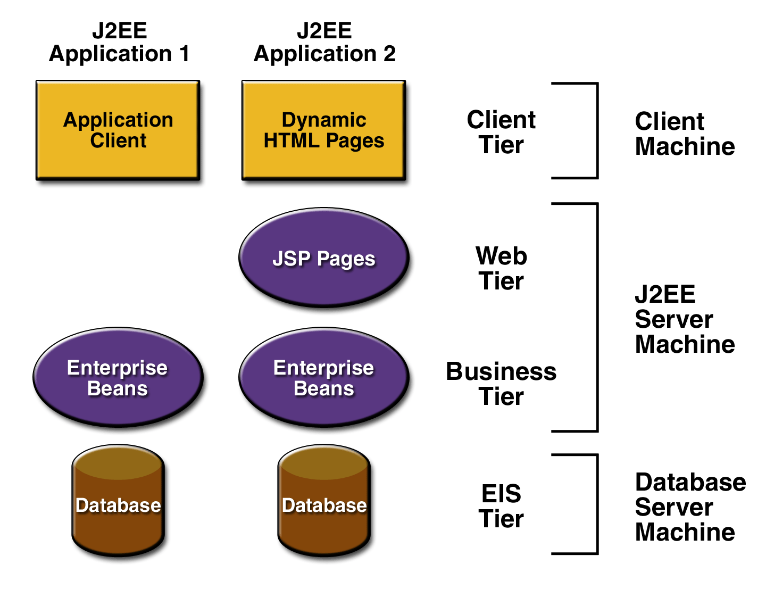
J2EE Architecture
J2EE multi-tiered applications are generally considered to be three-tiered applications because they are distributed over three different locations
  client machines
  the J2EE server machine
  the database or legacy machines at the back end

Slide 17
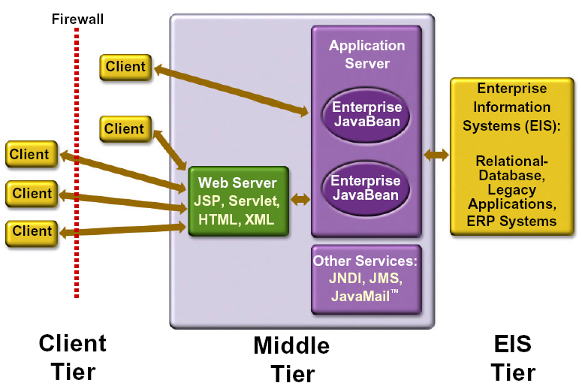
J2EE Architecture
Three-tiered applications that run in this way extend the standard two-tiered client and server model by placing a multithreaded application server between the client application and back-end storage

Slide 18
J2EE goals
Robustness
Scalability
Simplicity
Maintainability
Testability
Reusability

Slide 19
J2EE Containers
The application server maintains control and provides services through an interface or framework known as a container
There are five defined container types in the J2EE specification

Slide 20
J2EE Containers
Three of these are server-side containers:
  The server itself, which provides the J2EE runtime environment and the other two containers
  An EJB container to manage EJB components
  A Web container to manage servlets and JSP pages
The other two container types are client-side:
  An application container for stand-alone GUIs, console
  An applet container, meaning a browser, usually with the Java Plug-in

Slide 21
J2EE Container
Two most important containers:
Web Containers
EJB Containers
Web Components
(JSP/Servlets)
EJBs
Holds the following components:
  Entity beans
  Stateful session beans
  Stateless session beans
  Message beans
Manages threading for components
Provides necessary interface with web server
Containers provide medium for services to communicate with domain layer

Slide 22
J2EE Components
As said earlier, J2EE applications are made up of components
A J2EE component is a self-contained functional software unit that is assembled into a J2EE application with its related classes and files and that communicates with other components

Slide 23
Components
Client components run on the client machine, which correlate to the client containers
Web components -servlets and JSP pages
EJB Components

Slide 24
Packaging Applications and Components
Under J2EE, applications and components reside in Java Archive (JAR) files
These JARs are named with different extensions to denote their purpose, and the terminology is important

Slide 25
Various File types
Enterprise Archive (EAR) files represent the application, and contain all other server-side component archives that comprise the application
Client interface files and EJB components reside in JAR files
Web components reside in Web Archive (WAR) files

Slide 26
Deployment Descriptors
Deployment descriptors are included in the JARs, along with component-related resources
Deployment descriptors are XML documents that describe configuration and other deployment settings (remember that the J2EE application server controls many functional aspects of the services it provides)
The statements in the deployment descriptor are declarative instructions to the J2EE container; for example, transactional settings are defined in the deployment descriptor and implemented by the J2EE container

Slide 27
Deployment Descriptors
Most J2EE Web Services vendors provide a GUI tool for generating deployment descriptors and performing deployment because creating manual entries is tedious and error prone
The deployment descriptor for an EJB component must be named ejb-jar.xml, and it resides in the META-INF directory inside the EJB JAR file

Slide 28
EJB Components
EJB components are server-side, modular, and reusable, comprising specific units of functionality
They are similar to the Java classes we create every day, but are subject to special restrictions and must provide specific interfaces for container and client use and access
We should consider using EJB components for applications that require scalability, transactional processing, or availability to multiple client types

Slide 29
EJB Components- Major Types
Session beans
  These may be either stateful or stateless and are primarily used to encapsulate business logic, carry out tasks on behalf of a client, and act as controllers or managers for other beans
Entity beans
  Entity beans represent persistent objects or business concepts that exist beyond a specific application's lifetime; they are typically stored in a relational database

